Slide 1
Modeling Communication Systems Using the SystemC AMS Building Block Library
Jiong Ou¹, Farooq Muhammad¹, Christoph Grimm¹ and Martin Barnasconi²
Vienna University of Technology¹
NXP Semiconductors²

Slide 2
Outline
A brief introduction to the SystemC AMS extensions
Overview of the AMS Building Block Library
Application example: Modeling of OFDM Transceiver System
Conclusions and Future work

Slide 3
SystemC AMS extensions
SystemC AMS is not SPICE
SystemC AMS is not for circuit design – it‘s for overall system modeling!
Used in appropriate way, SystemC AMS yields
  high simulation performance
  increased design productivity

Slide 4
SystemC AMS extensions
Specification
Functional
Architecture
Implementation
RF
SoC
AMS
D
Interface
NEW
SystemC
AMS extensions
SystemC
VHDL-AMS,
Verilog-AMS
SystemVerilog,
VHDL, Verilog

Slide 5
AMS Building Block Library - Motivation
Problems:
  Slow simulation of AMS communication systems
  Modeling of different parts of a system needs a serious investment in time
  Limitations and constraints of closed (proprietary) models not always clear
Possible Solutions:
  Modeling in Timed Data Flow (TDF)
  Provides building blocks for various AMS, RF, and digital functions
  Using open model-based design approach

Slide 6
Available modules
Signal sources:
  Sine/Cosine, bit stream (uniformly), random number (gaussian) …
Signal processing:
  Basic mathematic modules: adder, multiplier, integrator …
  Analog modules: LNA, mixer, PLL, Butterworth/Chebyschev filter …
  Modulation processes: AM, BASK, M-FSK, M-PSK, DBPSK, OQPSK, QAM, OFDM …
  DSP algorithm: FFT/IFFT …
  Converter: A/D converter, D/A converter, P2S, S2P…
Analysis tools: eye diagram, scatterplot …

Slide 7
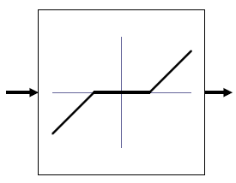
Non-ideal properties of analog
LNA:
  intermodulation products (IP3)
  output limitation
General modules of non-idealities:
Mixer:
  intermodulation products (IP3)
  output limitation
AD/DA converter :
  gain error
  offset error
  output limitation
Saturation
Dead zone
Columb funciton

Slide 8
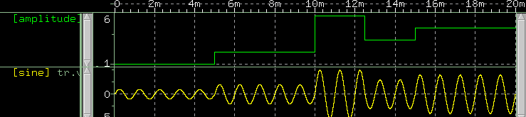
Paramerterization of modules
Generally: Adaptivity of modules is realized by parametrization of modules; realization could be DSP SW, FPGA, maybe analog
  setting parameters by instantiation
  parameter adjustments during simulation possible for some modules
Name value | Type | Default value | Description
n | sc_module_name | - | name of instant module
_gain | double | - | gain in dB
_ip3 | double | - | IP3 in dBm
_ideal | bool | - | true for simulation of ideal LNA, otherwise false

Slide 9
User-specific model extensions
The open nature of the AMS building block library enables making model extensions
  without changing the design architecture or structure!
Example: Add non-ideal effects to the model (e.g., noise)
+noise
+
void processing() {
out.write(ltf(…)+noise());
}
Noise
Model-based design with Matlab/Simulink®
Open model-based design approach
Jiong Ou, Farooq Muhammad, Christoph Grimm and Martin Barnasconi
9
Notes:
MB: proposal for a new slide copied from Christoph – tuned the text for this presentation – please check with Christoph if he agrees!

Slide 10
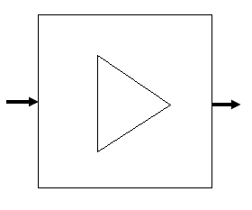
Building block example:
LNA header file
in
out
SCA_TDF_MODULE (lna)
{
public:
sca_tdf::sca_in<double> in; // Input port
sca_tdf::sca_out<double> out; // Output port
private:
double gain; // Gain in dB
double ip3; // Third Input Intercept Point in dBm
// Coefficients of output polynomial v = a*i - b*i*i - c*i*i*i
double a, b, c;
bool ideal; // ideal lna or not, true --> ideal
...
public:
// Constructor: name, gain in dB, ip3 in dBm, ideal (bool)
lna (sc_core::sc_module_name n, double _gain, double _ip3, bool _ideal);
...
private:
void processing(); // Timed Data Flow (TDF) processing method
};
LNA
Jiong Ou, Farooq Muhammad, Christoph Grimm and Martin Barnasconi
10

Slide 11
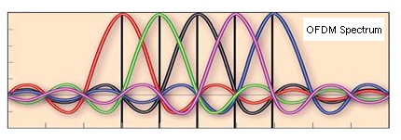
Example: OFDM Tranceiver(1)
OFDM: Orthogonal frequency-division multiplexing
OFDM
Transmitter
air
OFDM
Receiver
Notes:
A large number of closely-spaced orthogonal sub-carriers are used to carry data,

Slide 12
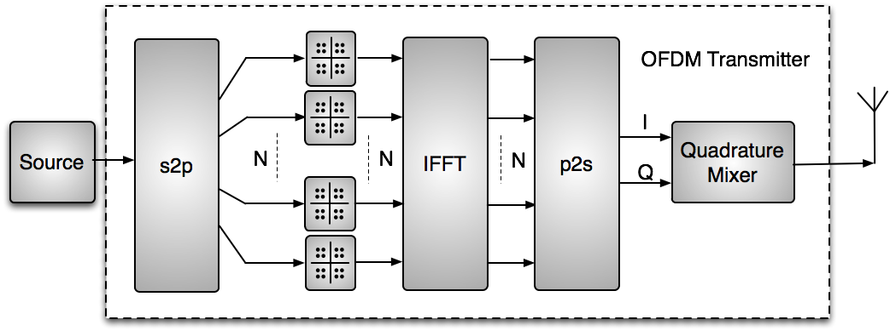
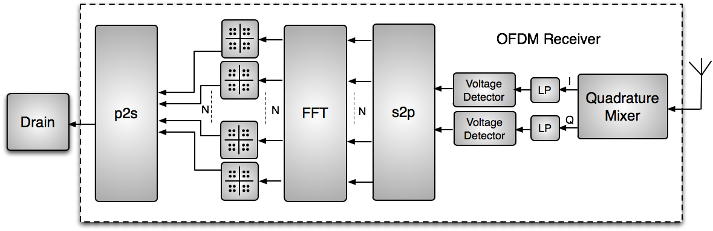
Example: OFDM Tranceiver(2)
Structure of the application:
air
channel

Slide 13
Example: OFDM Tranceiver(2)
/*** instantiate stimuli generator ***/
rand_bool i_stimuli("stimuli",16);
i_stimuli.out(sig_stimuli);
i_stimuli.out.set_timestep(1/freq_bit,SC_SEC);
/*** instantiate OFDM transmitter ***/
ofdm_se<8> i_tran("transmitter",freq_carrier,constl_dim,freq_bit,data_rate,ampl_se);
i_tran.in(sig_stimuli);
i_tran.out(sig_out);
/*** instantiate channel module ***/
air i_air("air",attent,"gauss_white",n_va);
i_air.in(sig_out);
i_air.out(sig_noise);
/*** instantiate OFDM receiver ***/
ofdm_re<8> i_receiver("receiver",freq_carrier,constl_dim,freq_bit,data_rate,ampl_re);
i_receiver.in(sig_noise);
i_receiver.out(sig_received);
/*** instantiate signal drain ***/
drain drn("drn");
drn.in(sig_received);

Slide 14
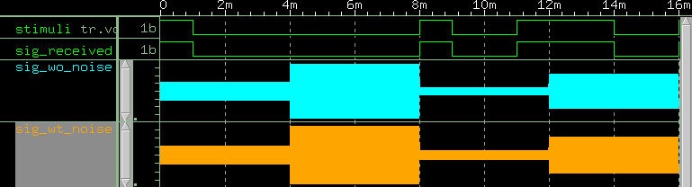
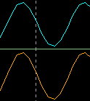
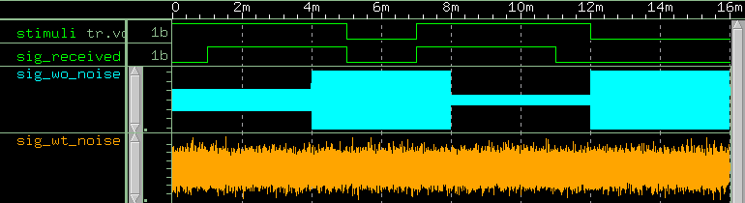
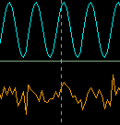
Simulation results(1)
Parameters for simulation: (no noise, no attenuation)
constl_dim = 16, n_va = 0.0, ampl_se = 1.0, ampl_re = 1.0, atten = 0.0
Parameters for simulation: (with strong white noise, no attenuation)
constl_dim = 16, n_va = 90.0, ampl_se = 1.0, ampl_re = 1.0, atten = 0.0

Slide 15
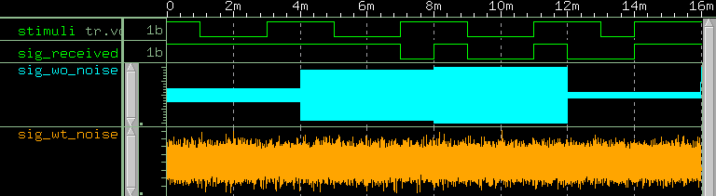
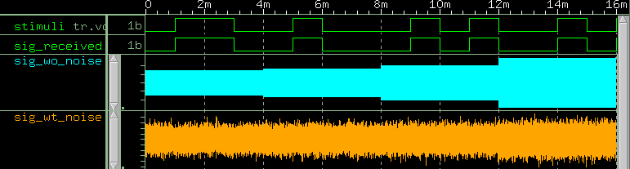
Simulation results(2)
Parameters for simulation: (with strong gaussian noise and 50% attenuation)
constl_dim = 16, n_va = 90.0, ampl_se = 1.0, ampl_re = 1.0, atten = 0.5
Parameters for simulation: (with strong white noise and 50% attenuation)
constl_dim = 16, n_va = 90.0, ampl_se = 20.0, ampl_re = 0.1, atten = 0.5
With higher transmission power, we can reproduce the correct signals again!

Slide 16
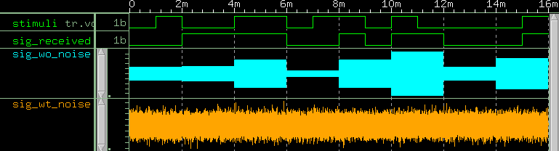
Simulation results(3)
Parameters for simulation: (with strong gaussian noise and 50% attenuation)
constl_dim = 4, n_va = 90.0, ampl_se = 1.0, ampl_re = 1.0, atten = 0.5
Or we can also slow down the transmission to improve the Bit Error Rate (BER).

Slide 17
Conclusions and Future work
It is convenient to model communication systems using the AMS building block library
  Open Source building block library is published and can be downloaded from http://www.systemc-ams.org/
  Already used by several companies for research purpose
Extend the Library with technology dependent information
  Evaluation of area and power consumption
  Enabling architecture exploration use cases

